Slide 1
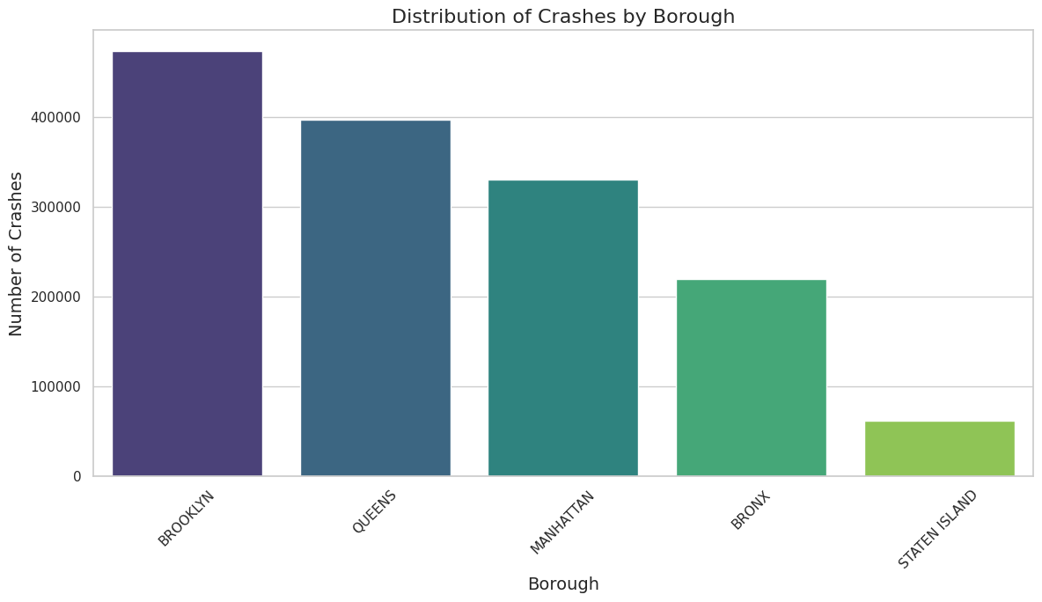
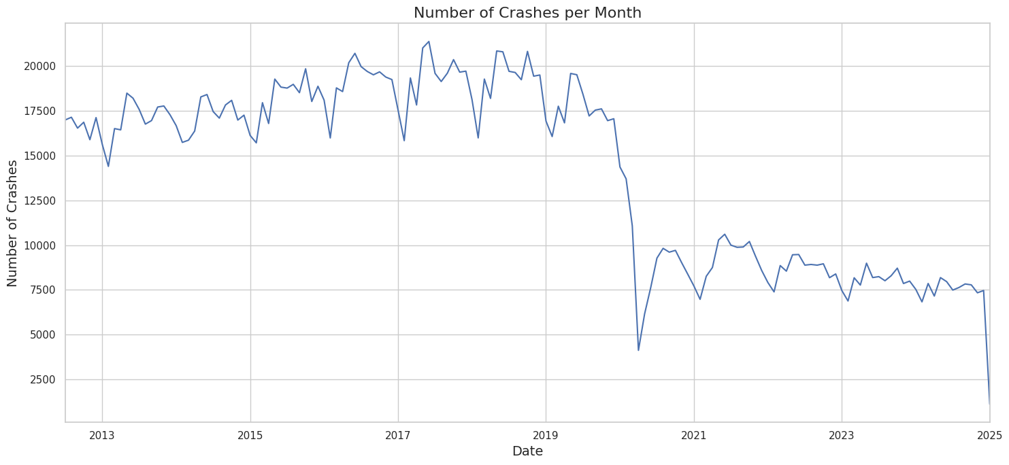
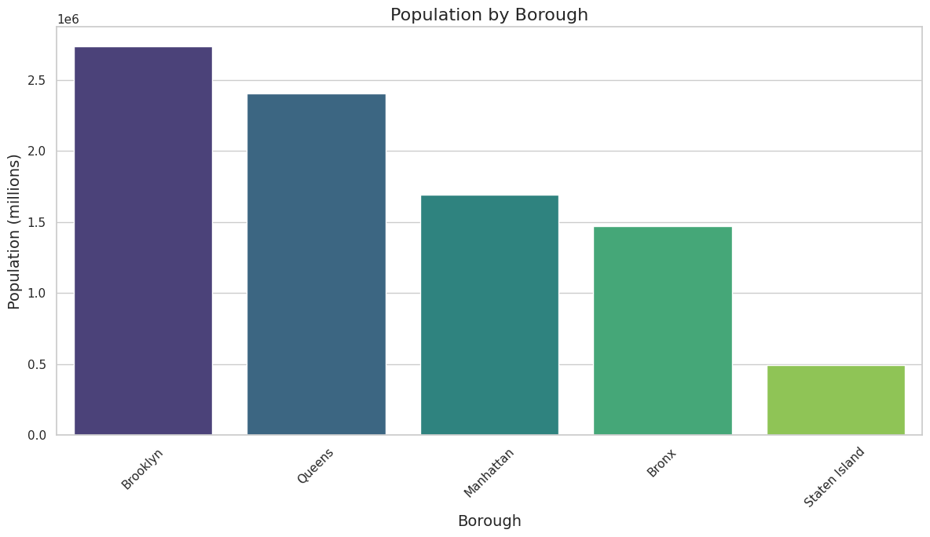
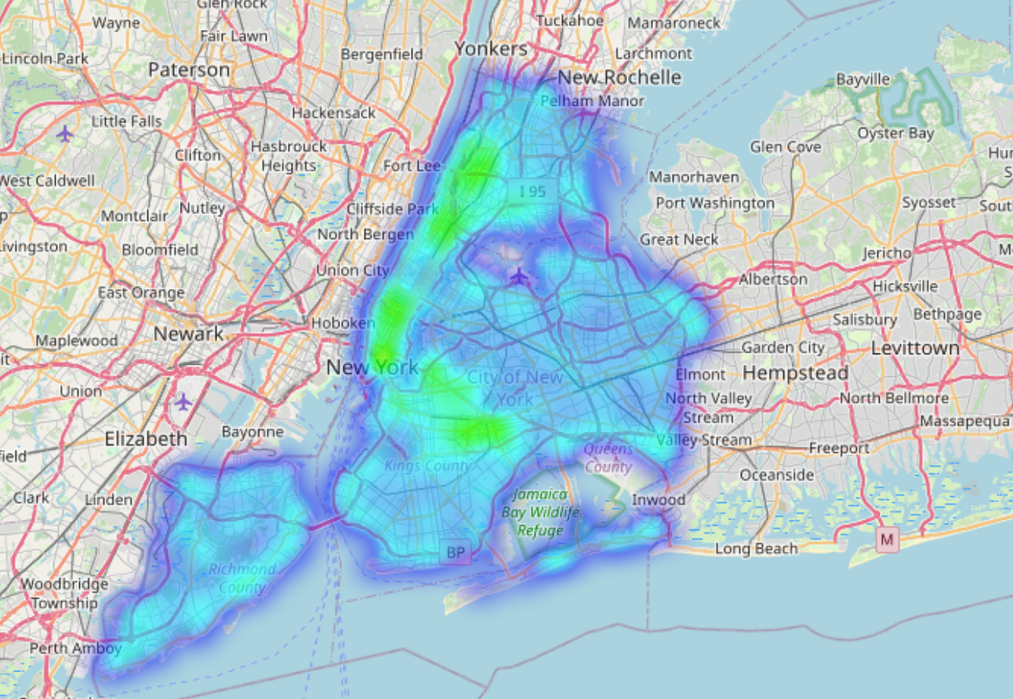
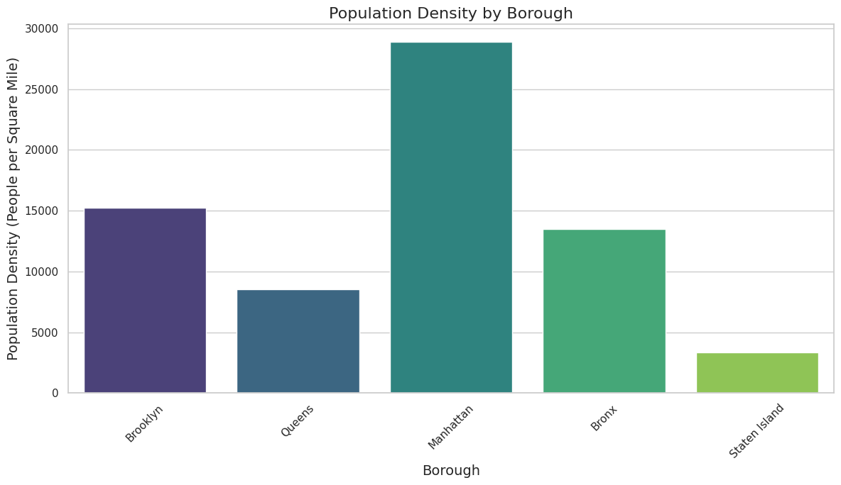
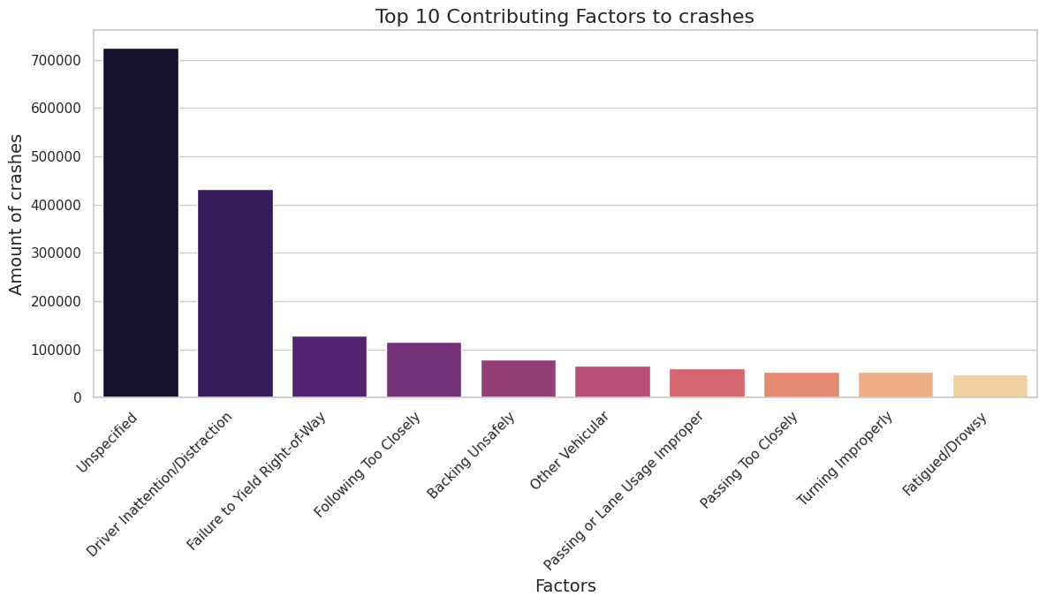
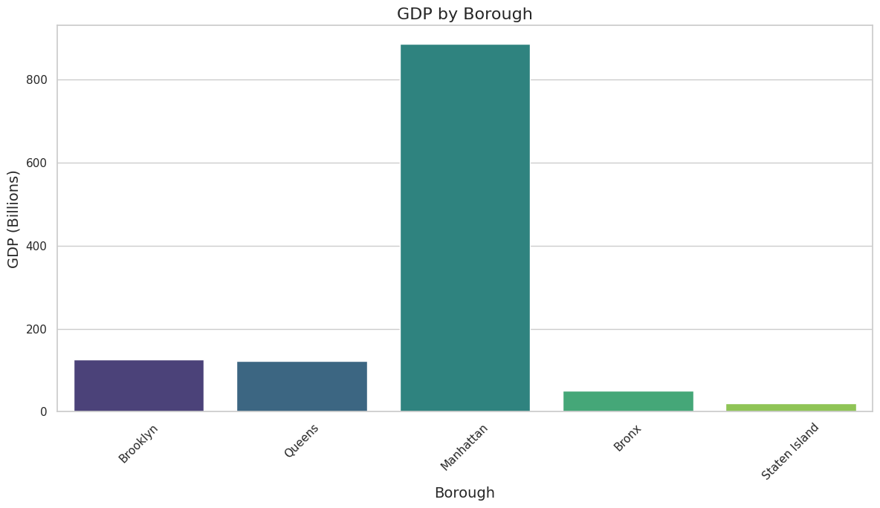
An examination of NYC accident data
Correlating Factors:
Research was performed on which factors seem to be most highly correlated with accidents. Population did, population density and size didn’t, and GDP might except for in Manhattan. Considering Manhattan’s GDP is important because it lets us examine if our data is overly focused on and catered towards well funded communities.
Time Series Analysis:
A graph of crashes over time in NYC. Shows a heavy decline after COVID.
Leading Causes of Accidents:
A chart of the top 10 causes for accidents. Most are from driver errors.
Heatmap:
A heatmap of crashes in NYC. Densest in Manhattan.
All data is from https://data.cityofnewyork.us

